Slide 1

An initial survey of the wave drifter data

Slide 2
TC relative observations
Observations are ALAMO float SST (°C) observations within 400 km of Hurricanes Irma and Florence in a storm‐centered, storm‐relative framework.
At each observation time, a range and bearing to the TC center is calculated and then plotted with bearing rotated relative to the TC motion.
Shaded arrows identify the direction of storm motion.

Slide 3
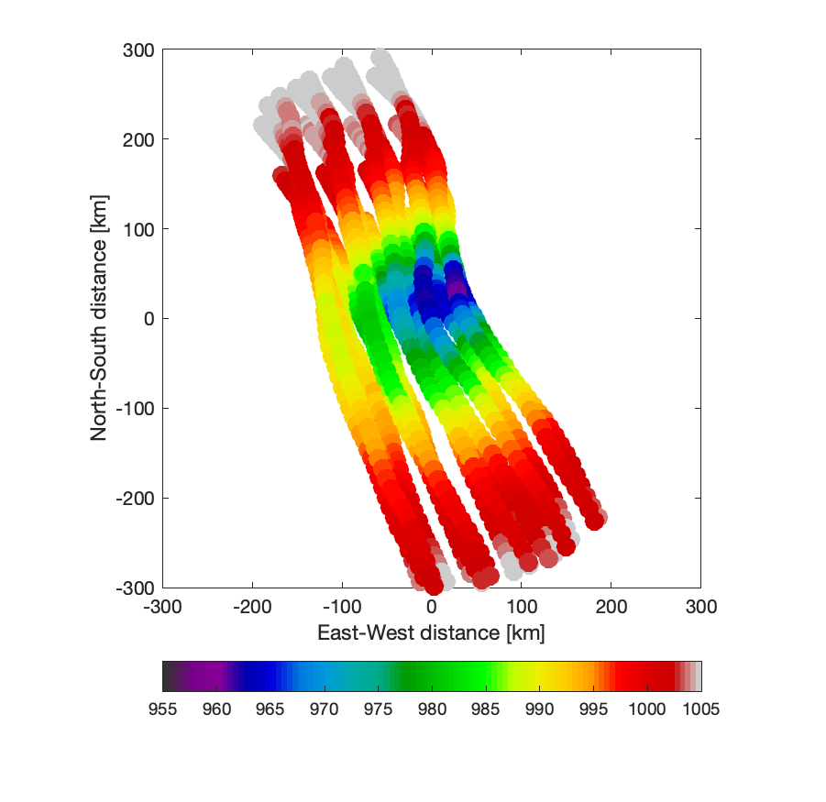
Sea level pressure reconstruction
Observations are sea level pressure from all 22 A-DWSB drifters.
Not rotated into storm translation direction as of now.
1204 total observations covering about ±1 day of the closest approach of Erin to the array within a CPA radius of 300 km.
Mostly observed the lefthand side of the storm, far fewer observations on the righthand side – track shifted to the east compared to forecast.

Slide 4
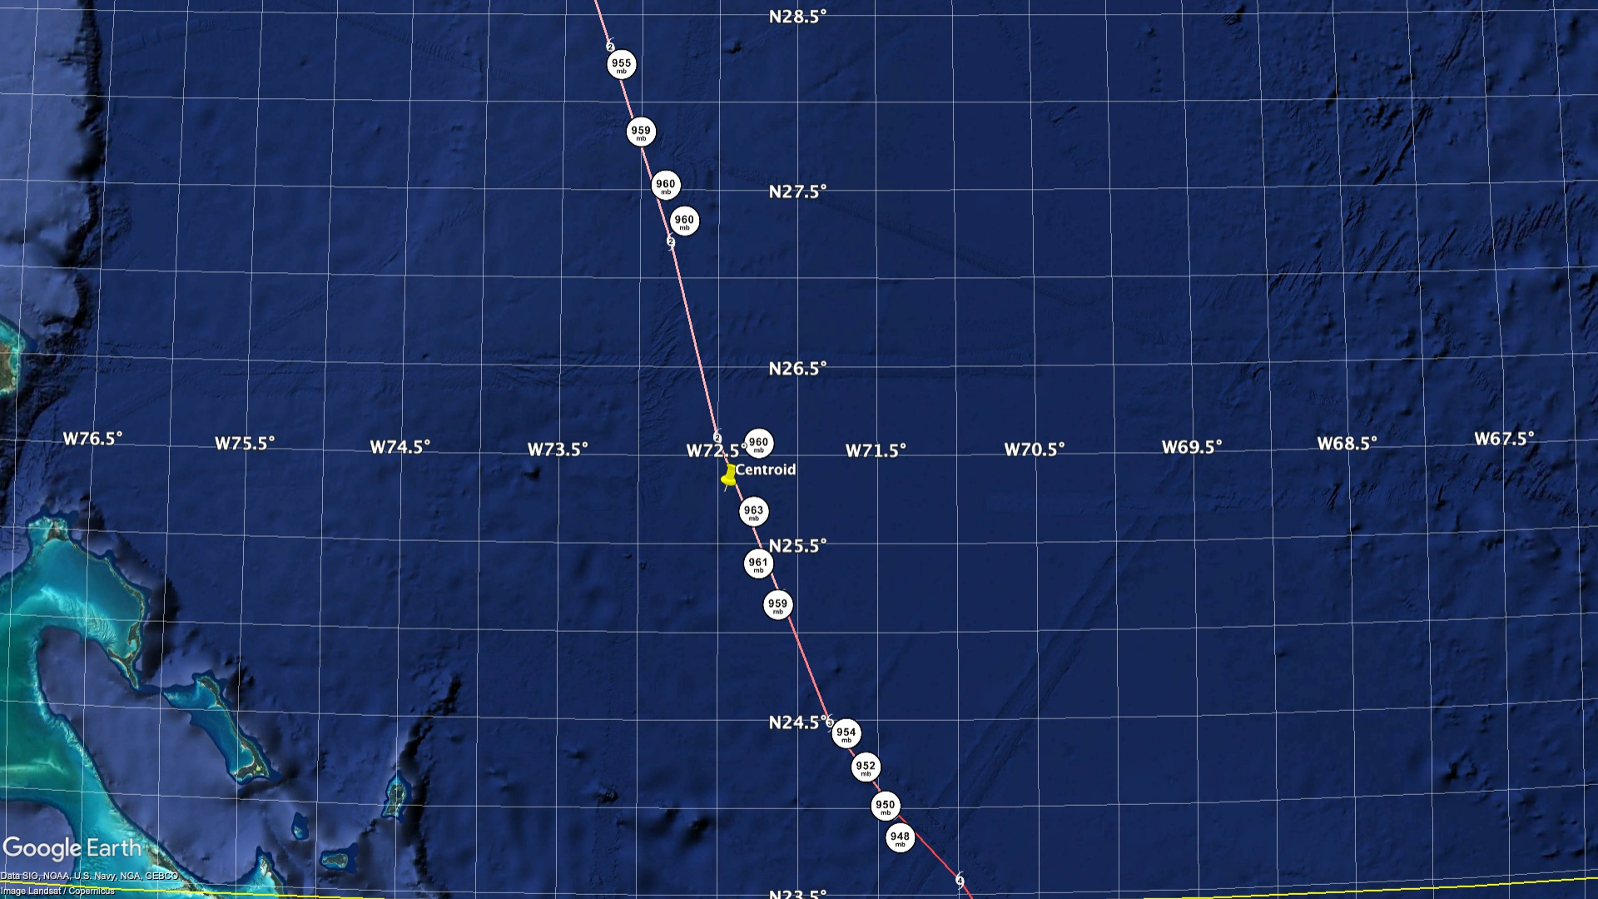

Slide 5
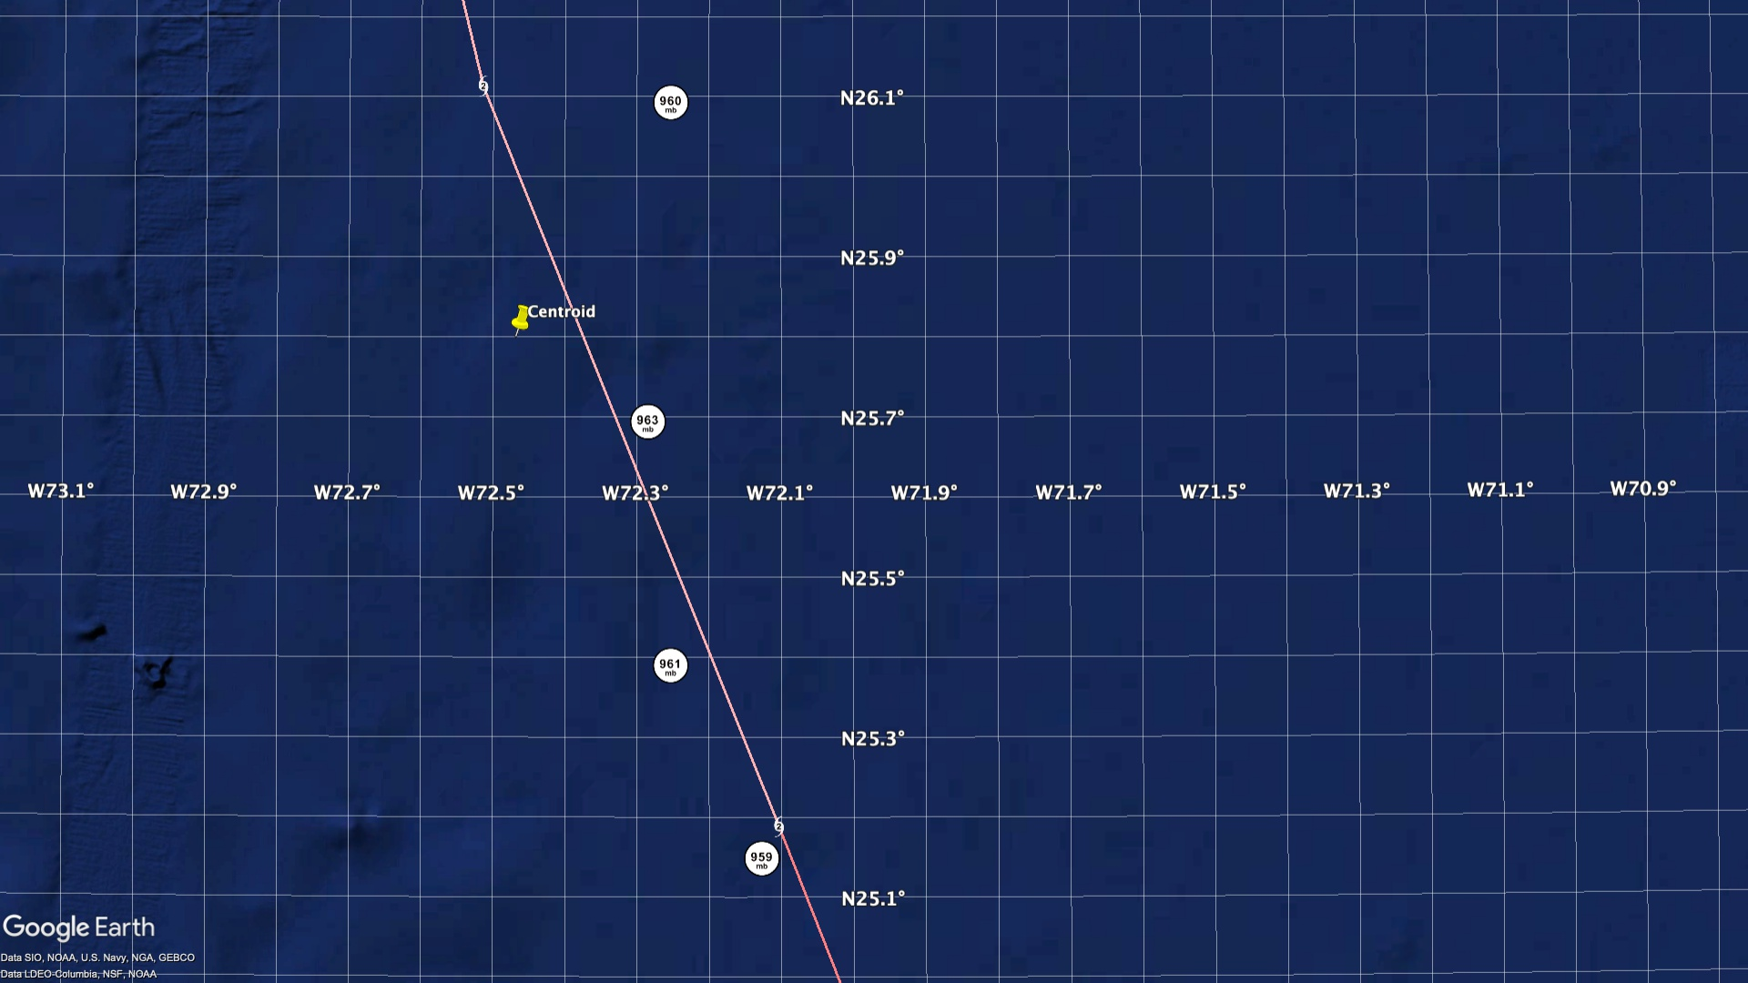

Slide 6
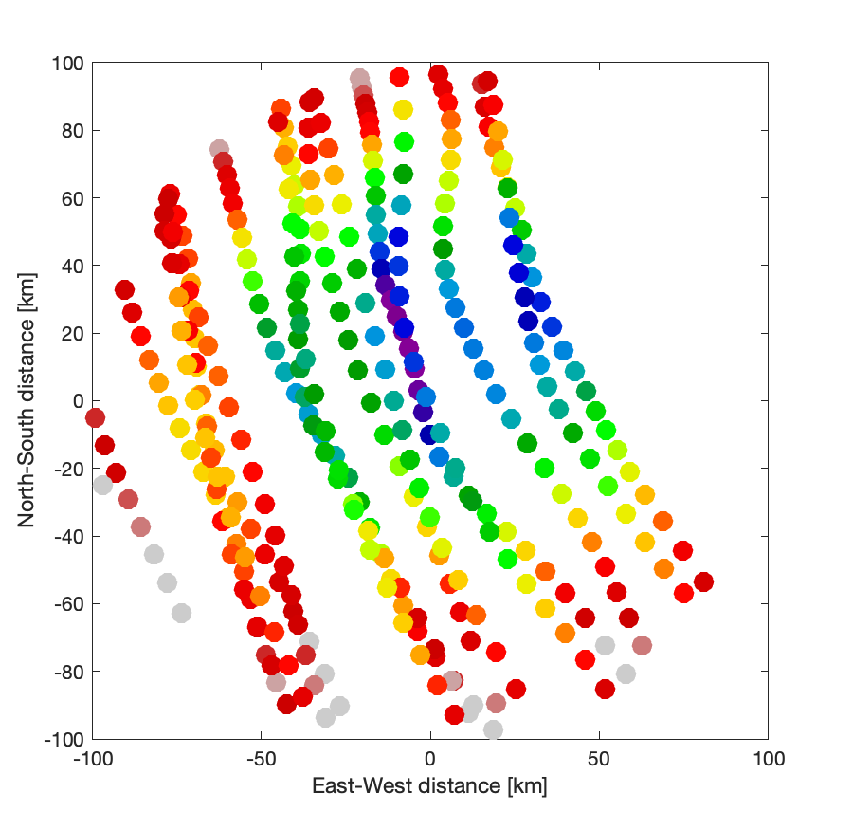
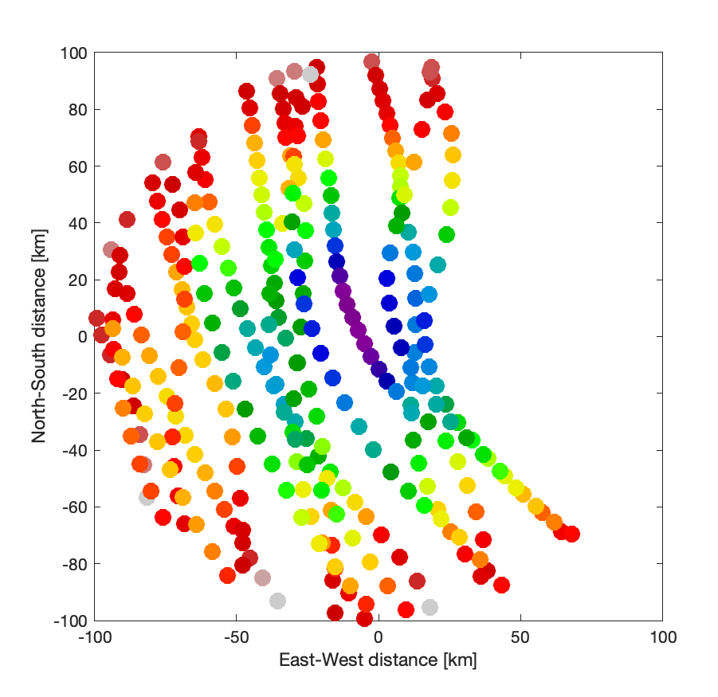
Details of the TC track matter for referencing obs…
Track 1: preliminary best track
Track 2: my track estimate

Slide 7
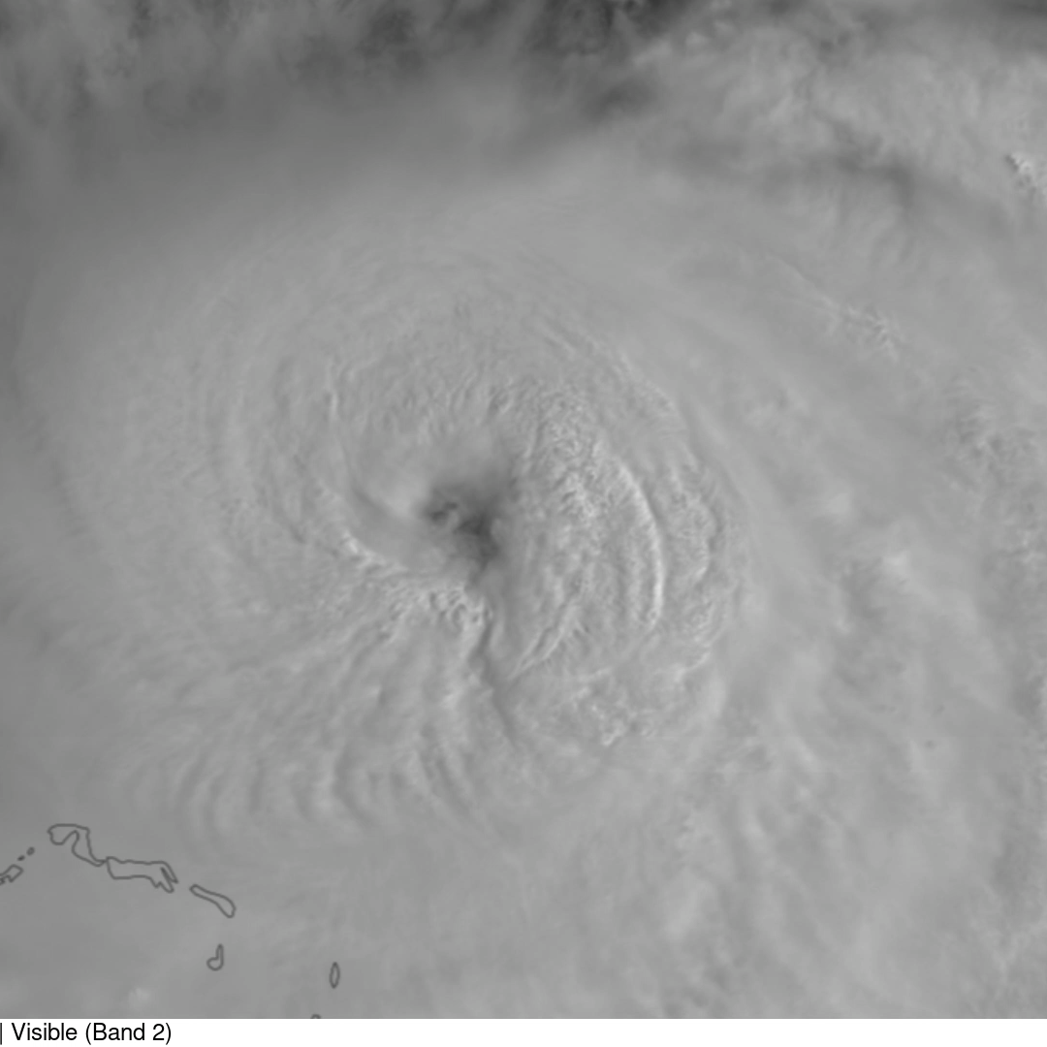
Higher-resolution track
We need more accurate and higher-temporal resolution best track data
HRD will produce a 2-minute track from aircraft observations.
Automated Rotational Center Hurricane Eye Retrieval (ARCHER) product doesn’t add a lot more temporal resolution.
ML or AI location retrievals using Particle Image Velocimetry (PIV) on geostationary satellite imagery could be used – at least in a hurricane’s mature phase.

Slide 8
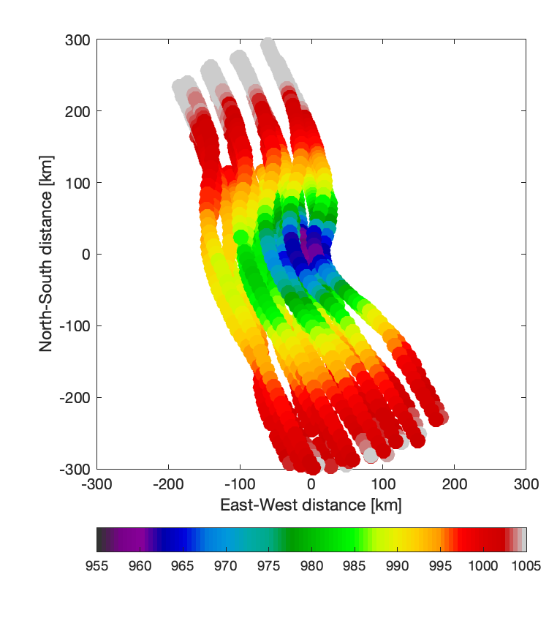
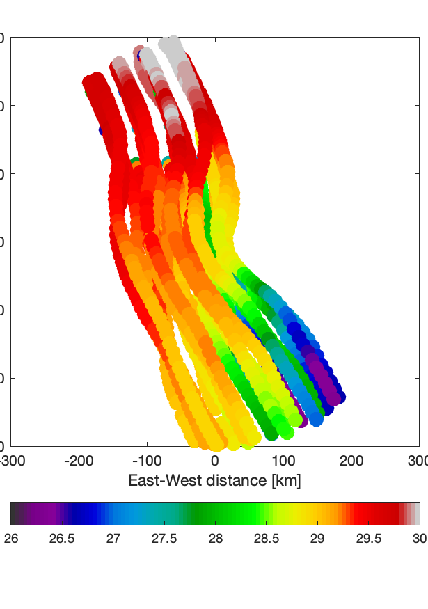
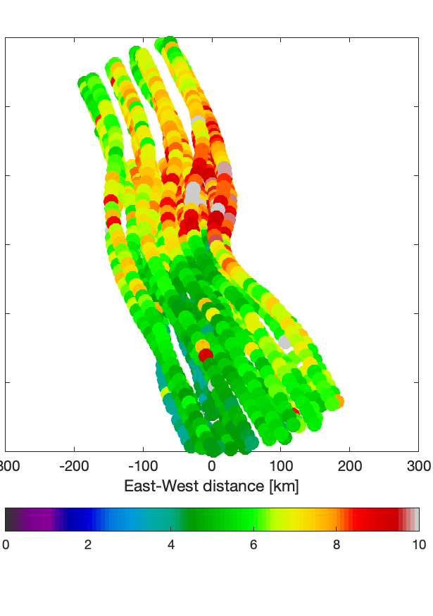
Quick initial survey of pressure, SST, and waves data
Sea level pressure
Sea surface temperature
Significant wave height

